Slide 1


NIT JALANDHAR
COURSE FILE GENERATOR

Slide 2

CONTENT
01
OUR TEAM
02
PROBLEM STATEMENT
03
FEATURES
04
SIGN-IN PAGE
05
SIGN-UP PAGE
06
FILE UPLOAD
07
FINAL MERGED FILE

Slide 3

OUR
Manpreet Singh (20103088)
Mrityunjay Kumar (20103092)
TEAM
Chandra Pareek (20103044)
Under the guidance of
Dr. Prashant Kumar

Slide 4
PROBLEM STATEMENT
Instructors are required to generate a comprehensive final report for each course upon completion, which includes information such as student marks, attendance records, grade summary, academic calendar, and timetables. However, creating this report can be an arduous task, especially if the instructor is responsible for multiple courses.
To streamline this process and save valuable time and energy, we have developed the Course File PDF Generator. This user-friendly tool is specifically designed to assist instructors in generating a merged file that includes a pre-defined set of information related to the course outcomes and templates.
With this tool, instructors need only upload the necessary files, and a polished, professional-quality PDF will be automatically generated. The Course Outcome PDF Generator allows instructors to create a comprehensive report for each course with minimal effort, helping to improve efficiency and enhance the quality of course administration.

Slide 5
Features
User Friendly
It is easy to use and understand for the average user, without requiring any specialized technical knowledge or training. It means that the product or software has an intuitive and straightforward interface, with clear instructions and minimal or no technical jargon.
Dynamic
The content of file changes and adapts in response to user's needs i.e. user can include multiple files including assignments, attendance sheets, lecture plans etc. User only needs to fill the form and based on that form appropriate course file will be generated.
Responsive
It automatically enables web pages to adjust and optimize their layout and content based on the user's device and screen size, so they can upload documents even from their mobile and get the course file.

Slide 6
Features
Time Saving
It will create document in proper format by only taking value of required field of that document along with this it will also order all the pages in proper way and allow user to download it.
Secure and Private
It provides protection of information or data from unauthorized access or modification by using proper authentication system. Also, the data provided by user is stored privately and access it limited to the concerned user only.

Slide 7
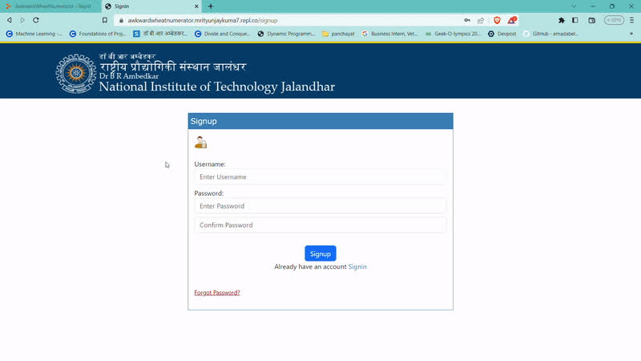
SIGN-UP
•The sign-up page is designed using HTML and CSS.
• The page contains input fields for name, email,
password, and confirm password.
• The architecture of the sign-up page involves Node.Js and MongoDB interacting with each other.
• It also contains a submit button that triggers the
Node.js code to store the user information in MongoDB.
• Node.js handles the server-side logic and serves the HTML and CSS files to the client.
•MongoDB stores the user information in a collection.

Slide 8
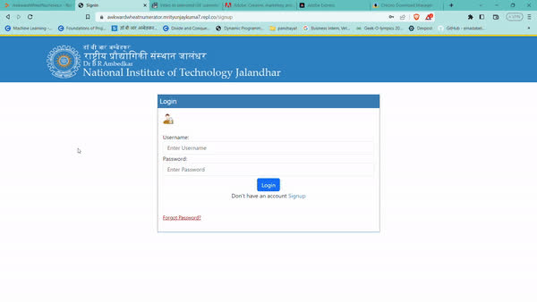
SIGN-IN
•The sign-in page is designed using HTML and CSS.
• The page contains input fields for email and password.
• It also contains a submit button that triggers the Node.js code to authenticate the user information with MongoDB.
• The Node.js code is written using the Express.js framework.
• It handles the server-side logic for the sign-in page, such as validating user input, comparing the hashed password with the one in the database, and authenticating the user.
• The code uses the MongoDB Node.js driver to interact with the database

Slide 9
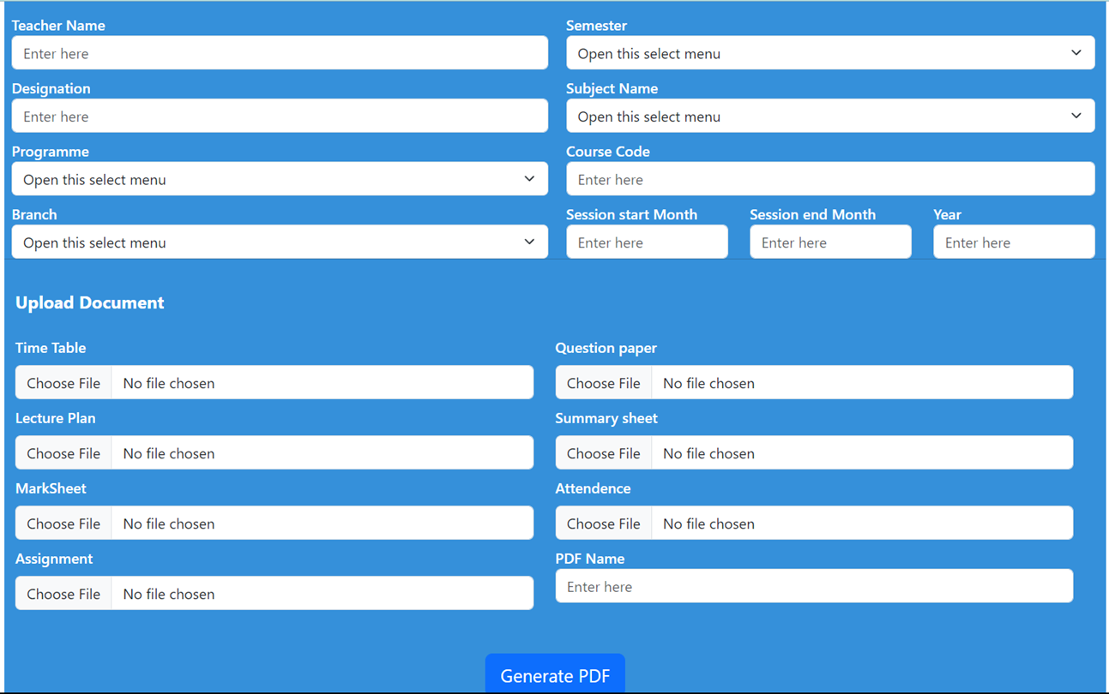
FORM
The proposed system allows instructors to effortlessly merge various documents into a professional-looking PDF format. By simply entering their name, course name, course code, semester, and degree program, instructors can upload the required documents and generate a merged PDF document with a built-in template. This system also allows for automatic document inclusion into the final PDF, based on the course. With this feature, instructors can ensure that all relevant materials are included in the final document.

Slide 10
MERGE PDF
We are merging multiple PDF files into one using Puppeteer library. Some of the common files such as vision, mission, programme outcomes are uploaded to cloud.
Dynamic pdfs are generated based on the teacher's name, course name, code and other details entered by user.
It contains the mergePDFs function which takes an array of PDF file paths as an argument and uses Puppeteer to merge them.
is compatible with multiple platforms, including Windows, macOS, and Linux. This means that the PDF merger application can be used on different operating systems.
the merging process can be fully automated, which saves time and effort for users.

Slide 11
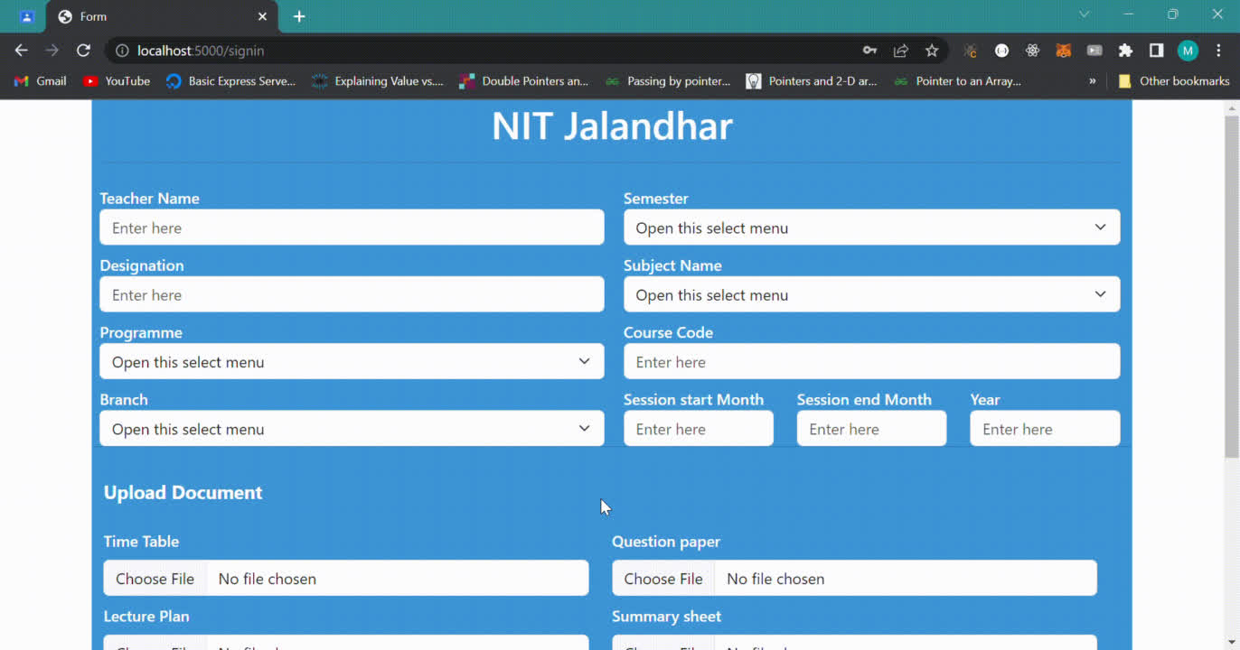

Slide 12


